Slide 1
Math at EHS
SOSR 2016-2017
Allie Shaw
Kirsten Ivey
Karen Price

Slide 2

Algebra 1
Backwards Design
School of Champions!

Slide 3
Backwards Design & The 8 Steps
Our Planning Process Order for Every Unit:
District Common Assessment Questions
EHS Common Assessment
Unit Calendar
Formative Assessments
8 Steps of High Preforming Teams
Data Disaggregation
Timeline
Instructional Focus
Assessment
Tutorials
Enrichment
Maintenance
Monitoring

Slide 4
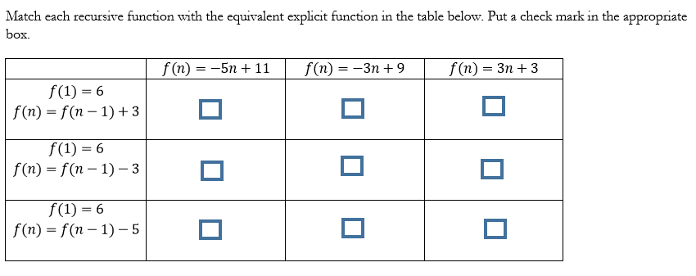
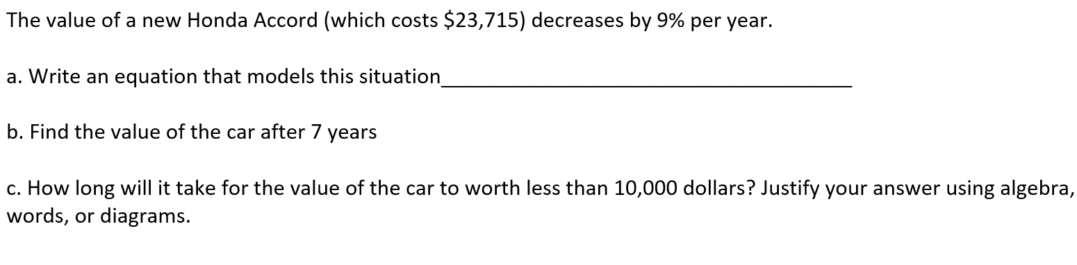
Backwards Design & The 8 Steps
District Common Assessment Questions: Examples
8 Steps of High Preforming Teams
Data Disaggregation
Timeline
Instructional Focus
Assessment
Tutorials
Enrichment
Maintenance
Monitoring

Slide 5
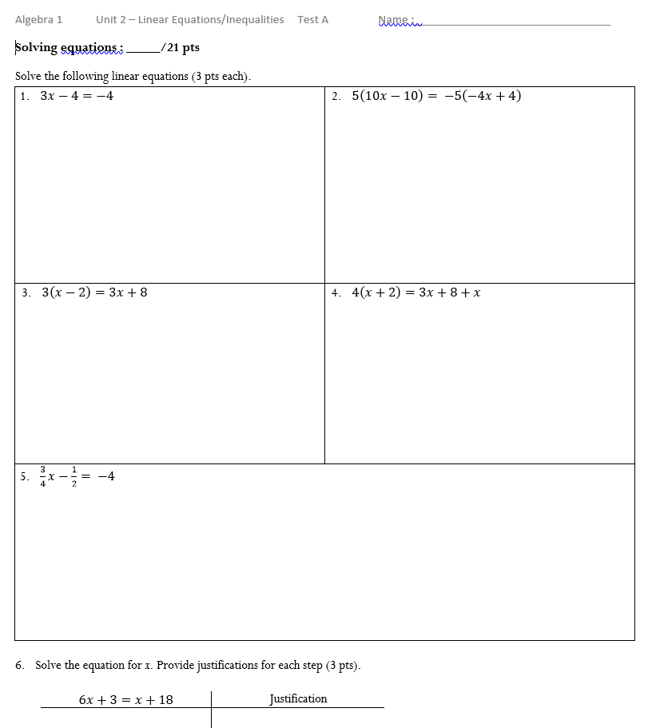
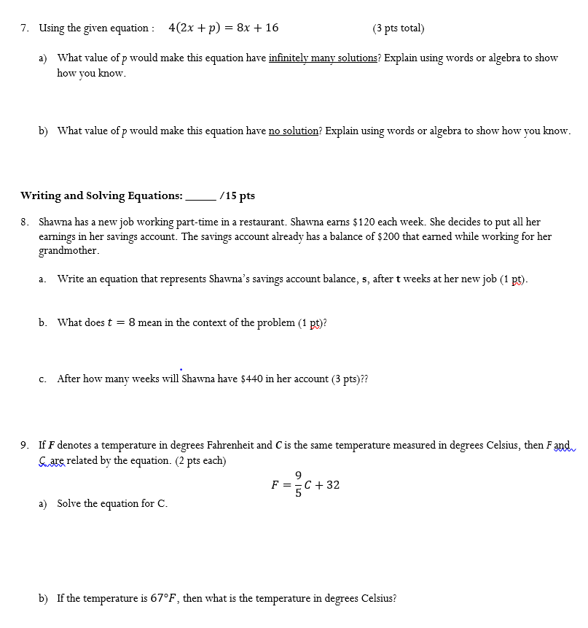
Backwards Design & The 8 Steps
EHS Common Assessments
District Questions
Plus, some of our own questions
8 Steps of High Preforming Teams
Data Disaggregation
Timeline
Instructional Focus
Assessment
Tutorials
Enrichment
Maintenance
Monitoring

Slide 6
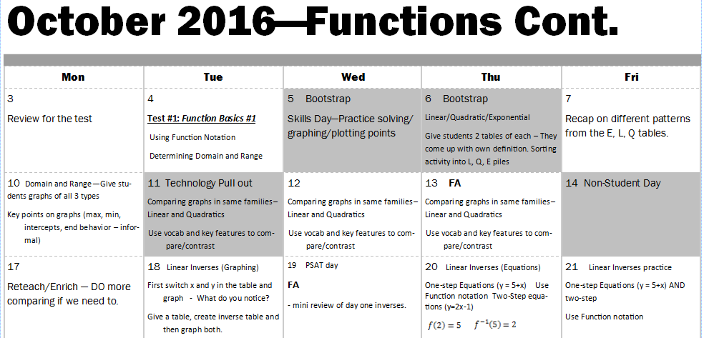
Backwards Design & The 8 Steps
Unit Calendar:
8 Steps of High Preforming Teams
Data Disaggregation
Timeline
Instructional Focus
Assessment
Tutorials
Enrichment
Maintenance
Monitoring

Slide 7
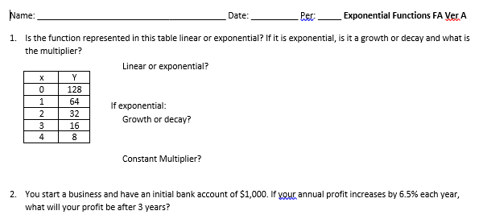
Backwards Design & The 8 Steps
Some Common Formative Assessments:
8 Steps of High Preforming Teams
Data Disaggregation
Timeline
Instructional Focus
Assessment
Tutorials
Enrichment
Maintenance
Monitoring

Slide 8
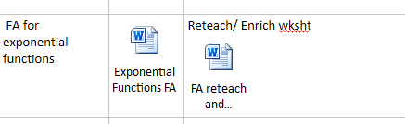
Backwards Design & The 8 Steps
Common Formative Assessments can be found on our OneNote.
8 Steps of High Preforming Teams
Data Disaggregation
Timeline
Instructional Focus
Assessment
Tutorials
Enrichment
Maintenance
Monitoring

Slide 9
Backwards Design & The 8 Steps
Based on their level of success on the Formative Assessments:
Reteach/Enrich Days as a class
Reteach/Enrich Activities for homework or review.
Differentiation for in-class activities.
8 Steps of High Preforming Teams
Data Disaggregation
Timeline
Instructional Focus
Assessment
Tutorials
Enrichment
Maintenance
Monitoring

Slide 10
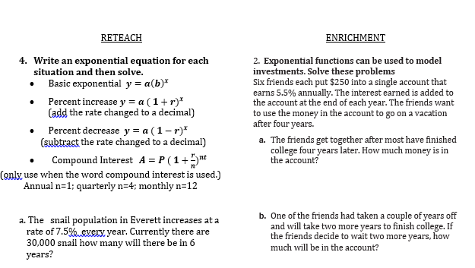
Backwards Design & The 8 Steps
Example:
8 Steps of High Preforming Teams
Data Disaggregation
Timeline
Instructional Focus
Assessment
Tutorials
Enrichment
Maintenance
Monitoring

Slide 11
Backwards Design & The 8 Steps
RETAKES on Common Summative Assessments:
Anyone can retake an assessment (with certain requirements for different classes)
Retake individual sections of the test (not the whole test)
8 Steps of High Preforming Teams
Data Disaggregation
Timeline
Instructional Focus
Assessment
Tutorials
Enrichment
Maintenance
Monitoring

Slide 12
Algebra 2
High Leverage Math Practices
School of Champions!

Slide 13
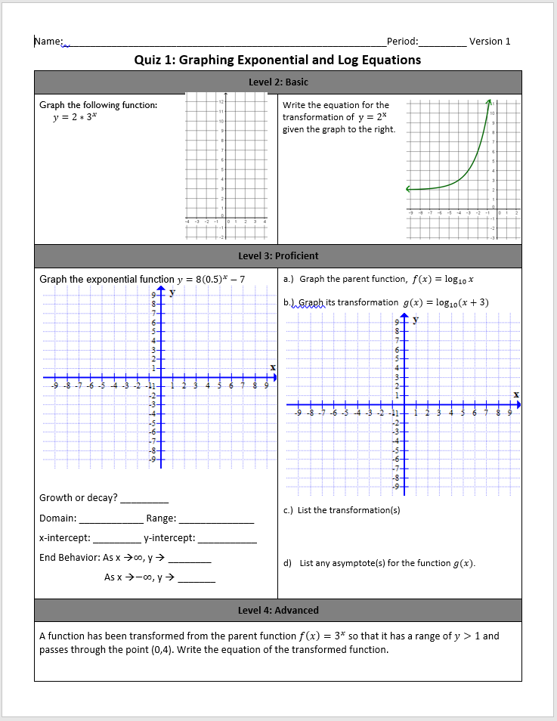
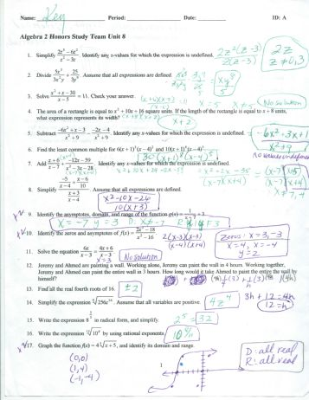
New Assessment Practice in ALGEBRA 2
Last
year
Big unit test
Mix of learning
Targets
Now
Weekly
assessments
Clear goals

Slide 14
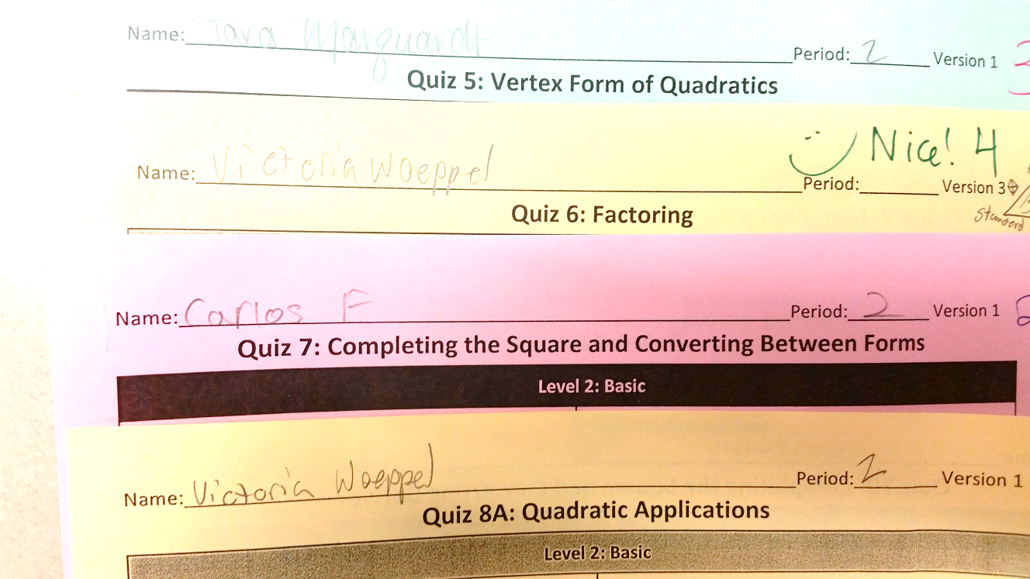
Benefits
8 Steps of Highly Performing teams
1. Data Disaggregation
2. Timeline Development
3. Instructional Focus
4. Assessment
5. Tutorials
6. Enrichment
7. Maintenance
8. Monitoring
Clearly defined learning targets

Slide 15
Entry points for all students
8 Steps of Highly Performing teams
1. Data Disaggregation
2. Timeline Development
3. Instructional Focus
4. Assessment
5. Tutorials
6. Enrichment
7. Maintenance
8. Monitoring

Slide 16

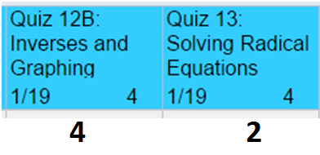
Changing our grading mindset
8 Steps of Highly Performing teams
1. Data Disaggregation
2. Timeline Development
3. Instructional Focus
4. Assessment
5. Tutorials
6. Enrichment
7. Maintenance
8. Monitoring
Traditional Grading
Standards Based Grading

Slide 17

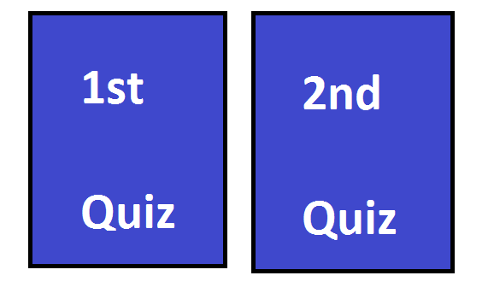
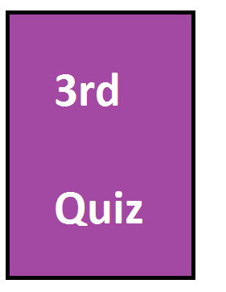
Fosters a Growth Mindset
8 Steps of Highly Performing teams
1. Data Disaggregation
2. Timeline Development
3. Instructional Focus
4. Assessment
5. Tutorials
6. Enrichment
7. Maintenance
8. Monitoring
In class:
Optional after school:

Slide 18
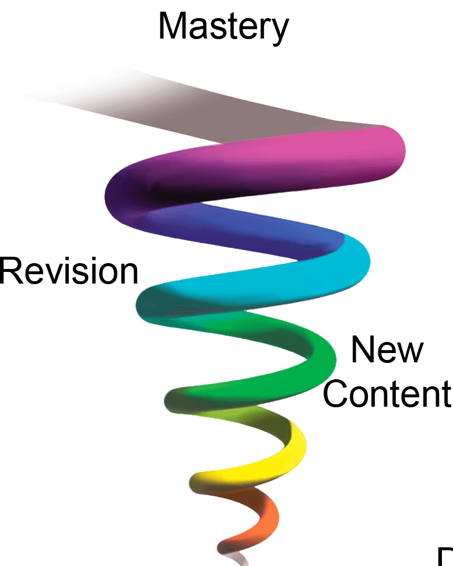
Retention/Spiraling
8 Steps of Highly Performing teams
1. Data Disaggregation
2. Timeline Development
3. Instructional Focus
4. Assessment
5. Tutorials
6. Enrichment
7. Maintenance
8. Monitoring

Slide 19
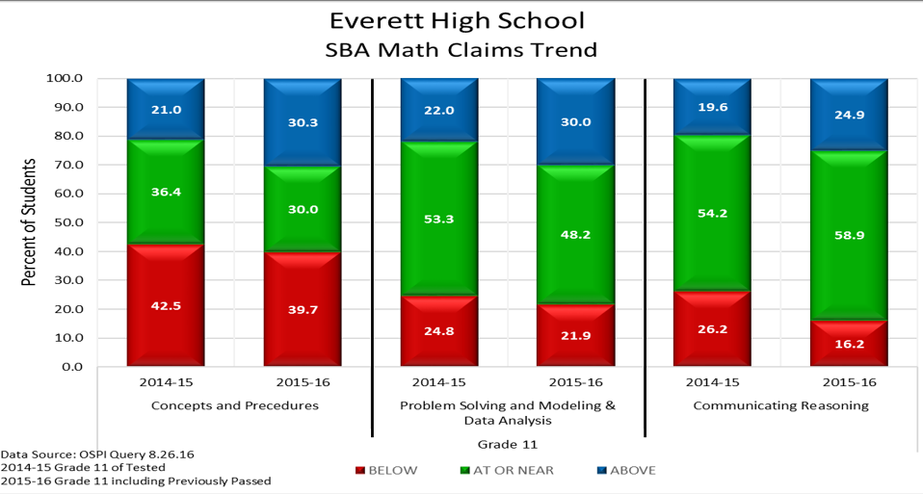

Slide 20
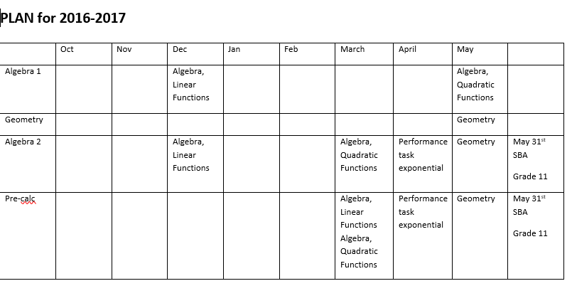

Slide 21
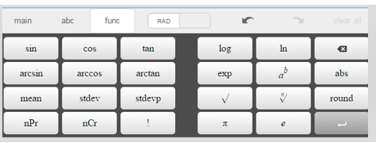

Slide 22
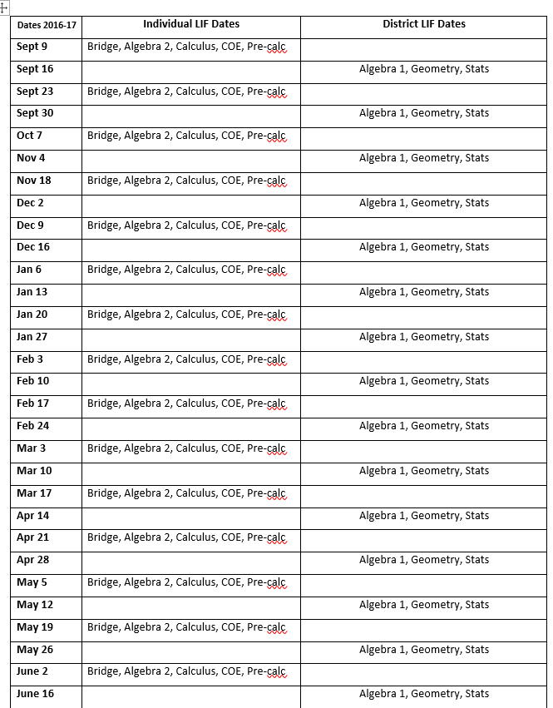

Slide 23
